Slide 1





Implementing global, sustained and multidisciplinary observations of plankton communities
The Plankton - MOB
Patricia Miloslavich, Nicholas Bax, Daniel Dunn, Frank Muller-Karger, Sonia Batten, Sanea Chiba, Ward Appeltans and GOOS BioEco Panel
http://goosocean.org/

Slide 2


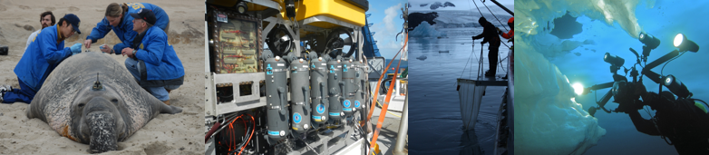
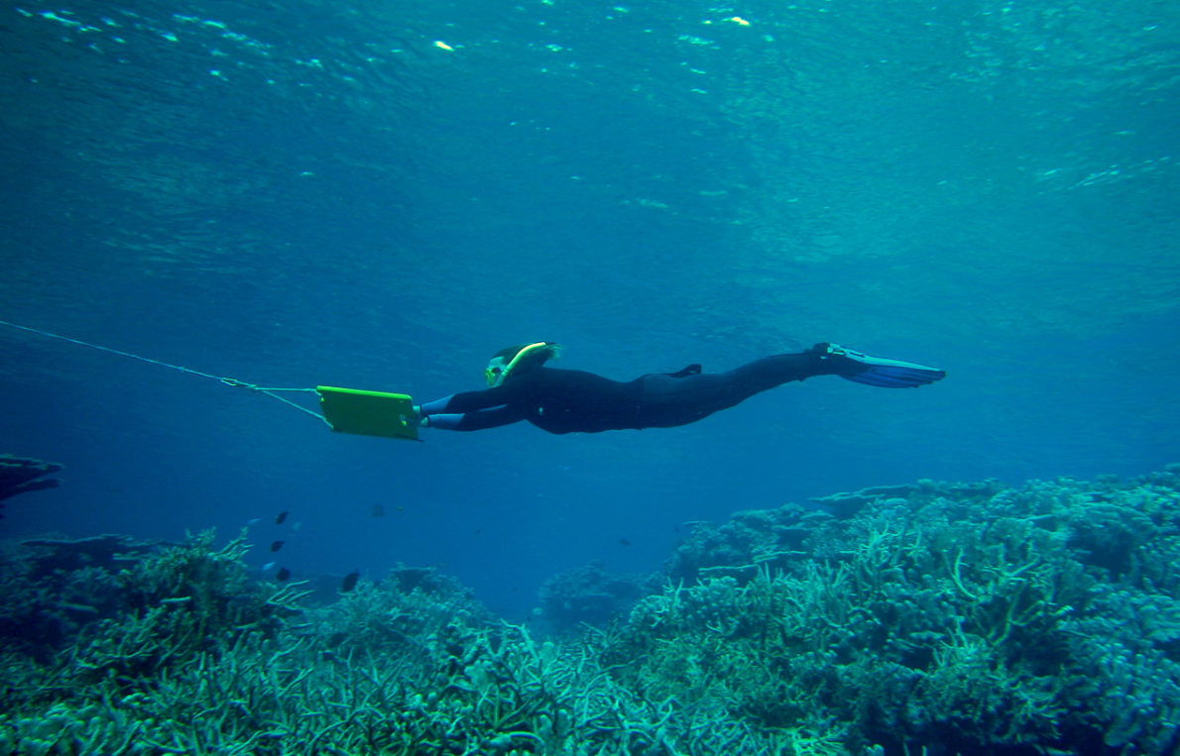
Tasks of GOOS Expert Panels
Physics – Biogeochemistry – Biology and Ecosystems
Identification of and requirement setting for Essential Ocean Variables (EOVs)
Development of EOV implementation strategies and coordination of observations
Promotion of standards and interoperability of data and information products
FOR BIOLOGY: BUILD THE GLOBAL NETWORKS
Photo credits: Dan Costa, Alistair Cheal, Eduardo Klein, Katrin Iken

Slide 3
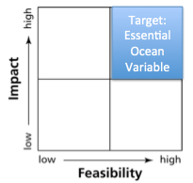
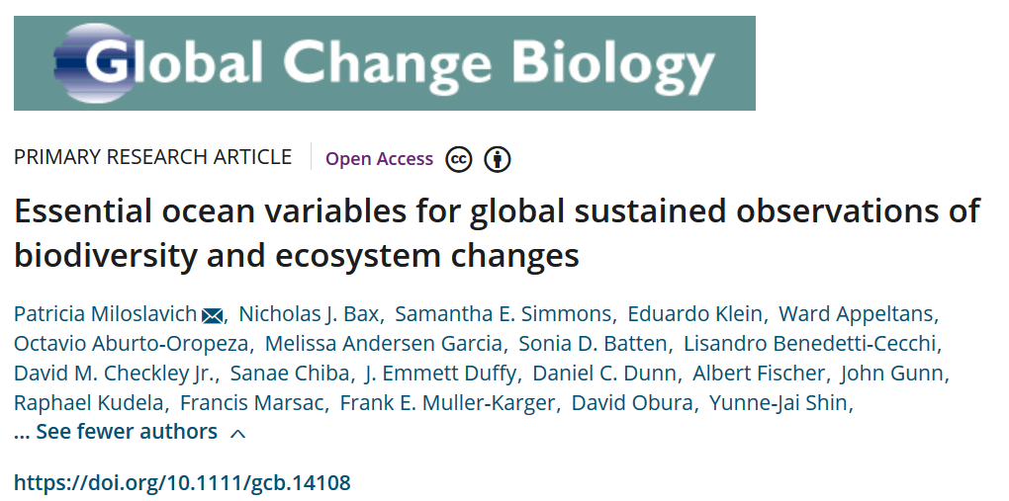
Process to identify biological Essential Ocean Variables
“Drivers-Pressures-State-Impact-Response”
Impact
-Relevant to help solve science questions and address societal needs
-Contribute to improve management of marine resources
Feasibility
-Scientifically credible
-Technically practical, cost effective and within human capabilities
Notes:
DPSIR: simple model developed by the EEA (European Environment Agency, 1995) to guide environmental assessment and reporting. Also used to guide prioritization of marine monitoring.

Slide 4
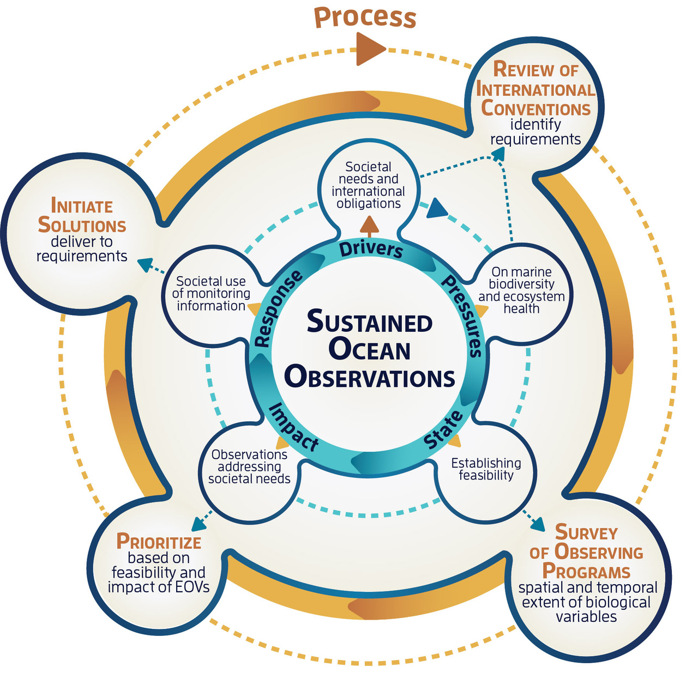
Process to identify biological Essential Ocean Variables
“Drivers-Pressures-State-Impact-Response”
Miloslavich et al. (2018) GCB
Notes:
DPSIR: simple model developed by the EEA (European Environment Agency, 1995) to guide environmental assessment and reporting. Also used to guide prioritization of marine monitoring.

Slide 5


















Process to identify biological Essential Ocean Variables
N=24 conventions
Miloslavich et al. (2018) GCB
Notes:
DPSIR: simple model developed by the EEA (European Environment Agency, 1995) to guide environmental assessment and reporting. Also used to guide prioritization of marine monitoring.

Slide 6



















Process to identify biological Essential Ocean Variables
N=104 observing programs
Miloslavich et al. (2018) GCB
Notes:
DPSIR: simple model developed by the EEA (European Environment Agency, 1995) to guide environmental assessment and reporting. Also used to guide prioritization of marine monitoring.

Slide 7


Process to identify biological Essential Ocean Variables
Papers (1995-2016):
Drivers: 12000+
Pressures: 65000+
Variables: 7000+
Miloslavich et al. (2018) GCB
Notes:
DPSIR: simple model developed by the EEA (European Environment Agency, 1995) to guide environmental assessment and reporting. Also used to guide prioritization of marine monitoring.

Slide 8
Process to identify biological Essential Ocean Variables
EOV
Validation
Integration
Implementation
PRODUCT DELIVERY
Miloslavich et al. (2018) GCB
Notes:
DPSIR: simple model developed by the EEA (European Environment Agency, 1995) to guide environmental assessment and reporting. Also used to guide prioritization of marine monitoring.

Slide 9
Observing programs: spatial and temporal scales
Miloslavich et al. (2018) GCB

Slide 10
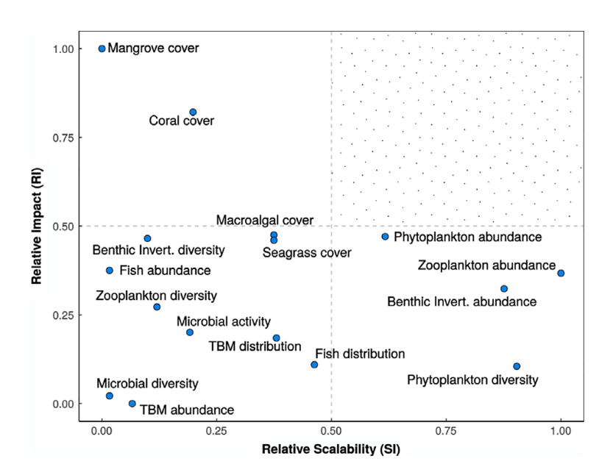
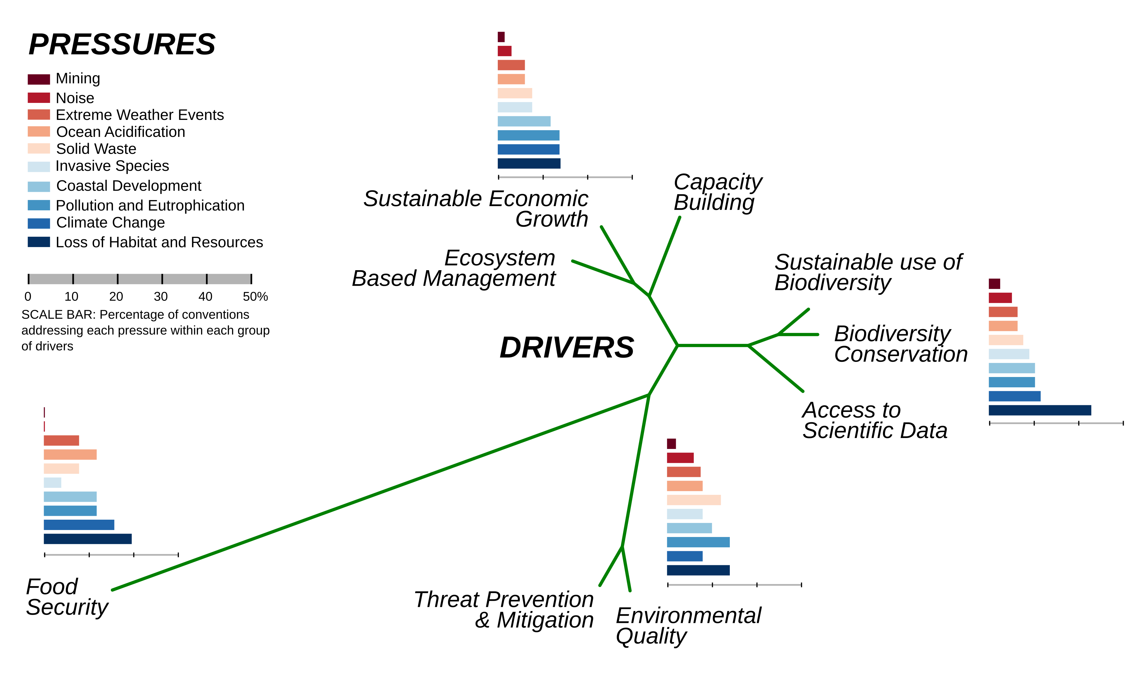
Impact and scalability of prioritized variables
Societal drivers and pressures
(from conventions)
Scalability: Weights temporal and spatial scales
Notes:
Results of SCOPUS literature search. Search of “variables” for each of the drivers and the pressures. Blank squares indicates no literature reference. See search codes in Excel file. TBM= Turtles, birds, mammals.

Slide 11
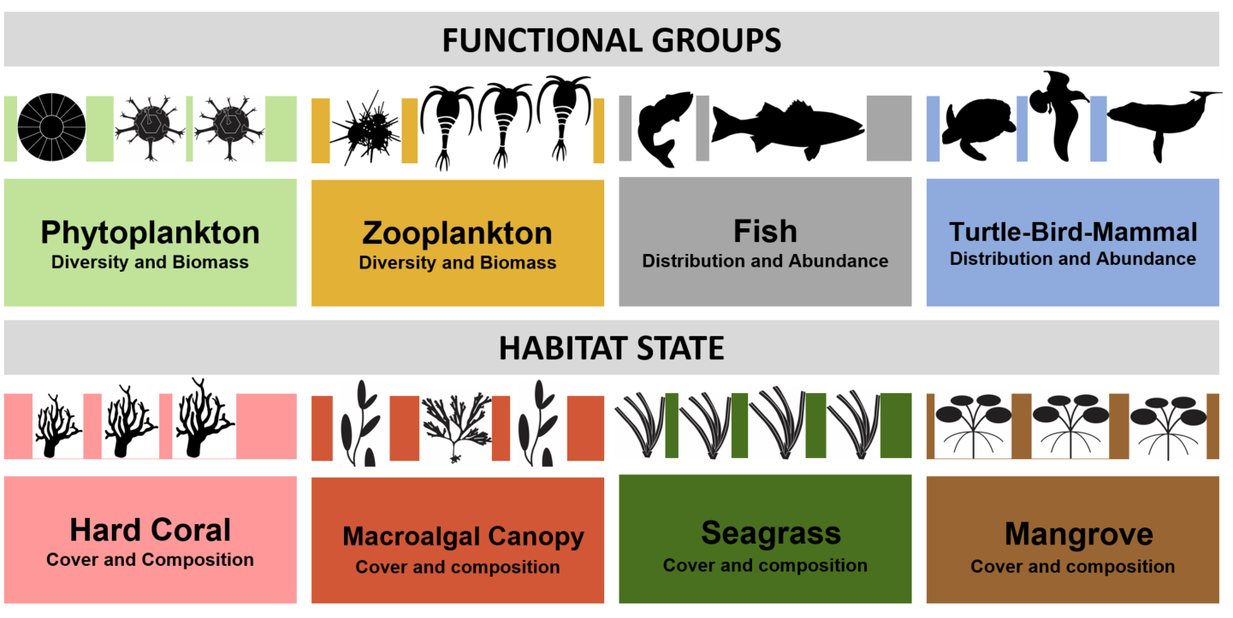
GOOS Biological / Ecological
Essential Ocean Variables
Peer reviewed specification sheets at:
goosocean.org/eov
Emerging EOVs: Microbial diversity and biomass
Benthic invertebrate distribution and abundance

Slide 12
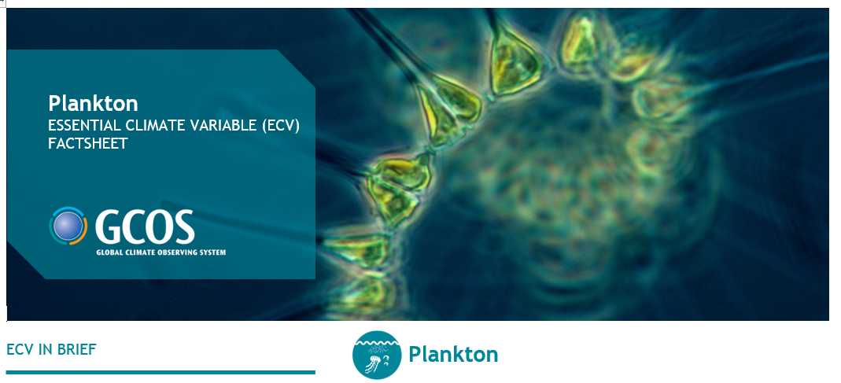
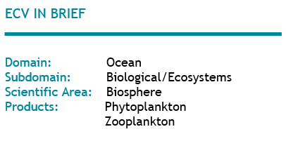
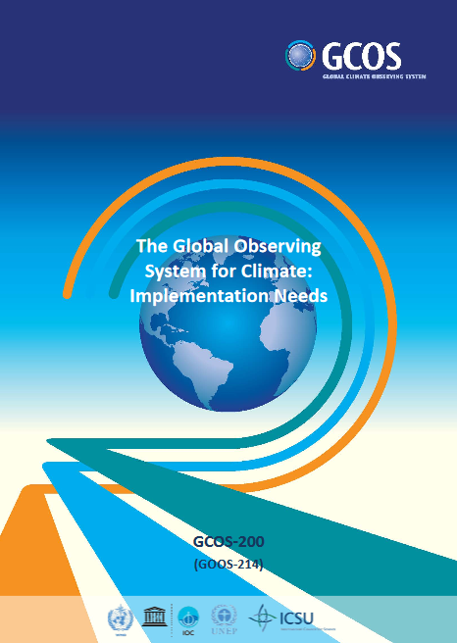
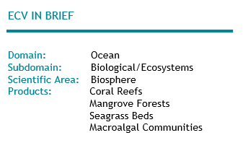
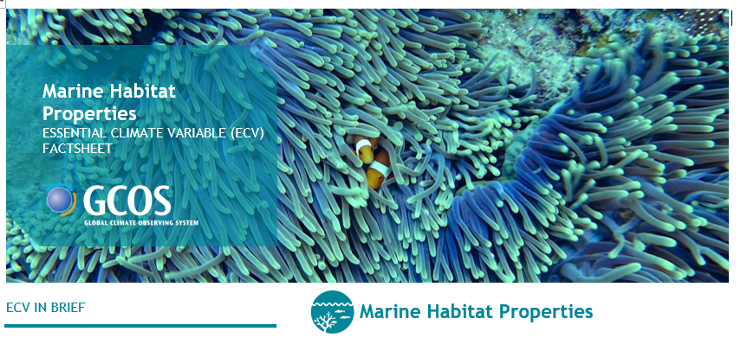
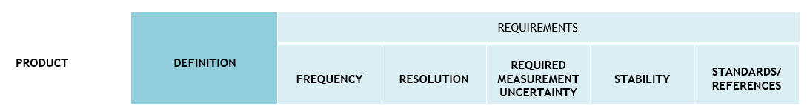
Value of EOVs for the global CLIMATE observing system GCOS
Notes:
IMSOO: Implementation of Multi-Disciplinary Sustained Ocean Observations
GEO BON/MBON – GOOS BioEco – OBIS partnership
Building a globally coherent, consistent and coordinated sustained global ocean observing system to assess the state of the ocean’s biological resources and ecosystems

Slide 13
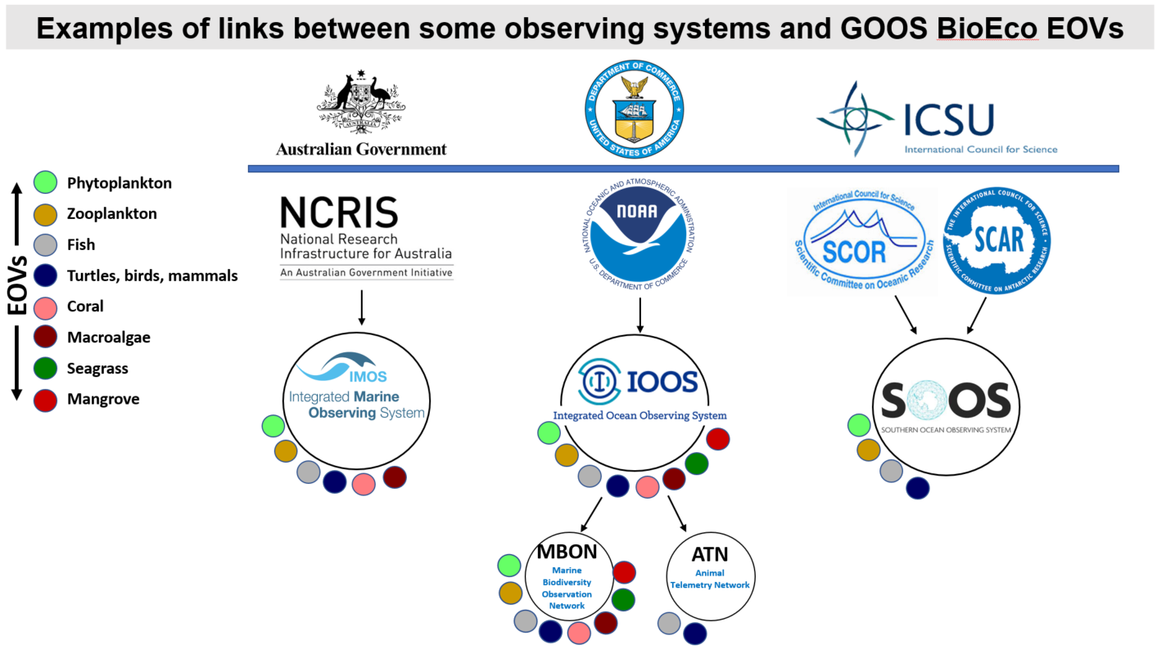
Value of EOVs for the global ocean observing system
Notes:
IMSOO: Implementation of Multi-Disciplinary Sustained Ocean Observations
GEO BON/MBON – GOOS BioEco – OBIS partnership
Building a globally coherent, consistent and coordinated sustained global ocean observing system to assess the state of the ocean’s biological resources and ecosystems

Slide 14
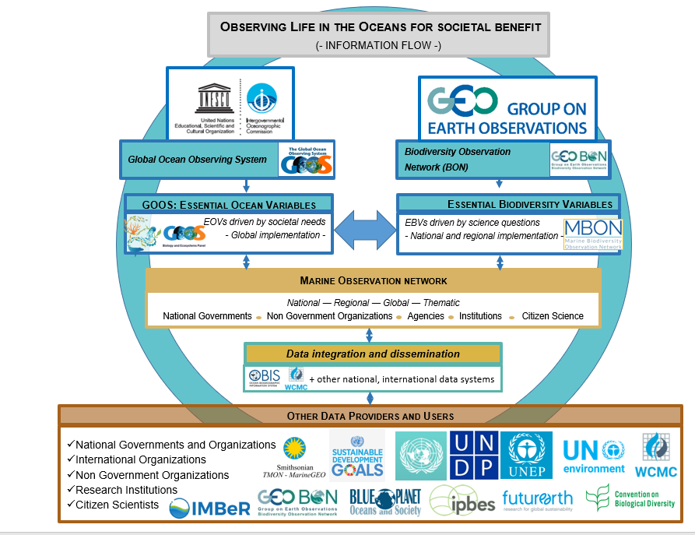
Building the global ocean observing system
INTEGRATION
BioEco-MBON-OBIS
Support science and policy
Contribute to UN Decade of the Ocean
Notes:
IMSOO: Implementation of Multi-Disciplinary Sustained Ocean Observations
GEO BON/MBON – GOOS BioEco – OBIS partnership
Building a globally coherent, consistent and coordinated sustained global ocean observing system to assess the state of the ocean’s biological resources and ecosystems

Slide 15









HIGHLIGHTS 2017/2018
IMPLEMENTATION: needs, requirements and gaps
Drafting the implementation plans
-global coordination and coverage
-intercomparable: best practices
-open access data
-support international reporting needs
-aiming to build a network around each EOV
November 2017
Dar es Salaam, Tanzania
EOV IP Workshops
June 2018
Santa Cruz, CA, USA
Vision and mission
Needs and requirements
Capabilities
Impact - capacity development
Funding
Governance
September 2018
Hobart, Australia

Slide 16
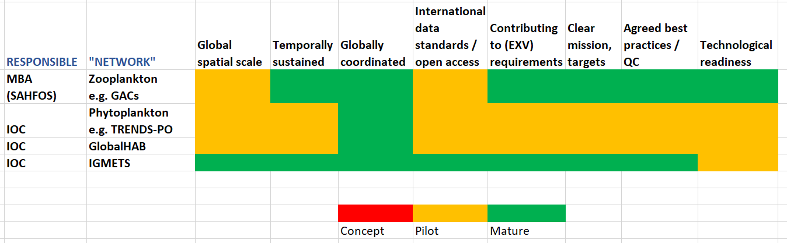
Biological ocean networks: some examples / OCG criteria

Slide 17
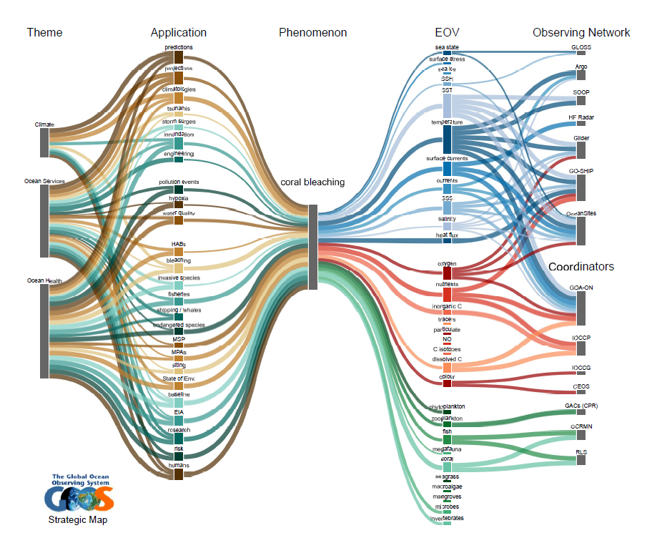
GOOS Strategic mapping
Link to strategic mapping for case example
“Bleaching”

Slide 18
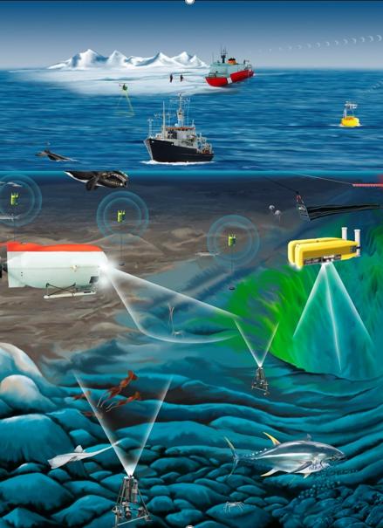
Challenges
Communities of practice rather than networks
Most mature networks are local/regional (IMOS in Australia, IOOS in the USA)
Many “individual” / local efforts contributing
Sustainability not global but on a case to case basis
Heterogeneity in technology, capacity and funding – automatization very limited
Best practices in discussion – collection of, rather than one method
Some of the “networks” only compile data from observations rather than doing the observations (e.g. IGMETS)
Willingness to collaborate but need more support for coordination

Slide 19
Workshop outputs
Draft implementation plans to develop the Phytoplankton diversity and biomass and Zooplankton diversity and biomass EOVs from a multidisciplinary perspective.
Draft a pilot project (proposal?) to test such multidisciplinary approach to plankton observations considering one or more platforms, locations and through integration with a GOOS Regional Association and/or project.
Draft the outline of the global plankton observation community paper for OceanObs19

Slide 20
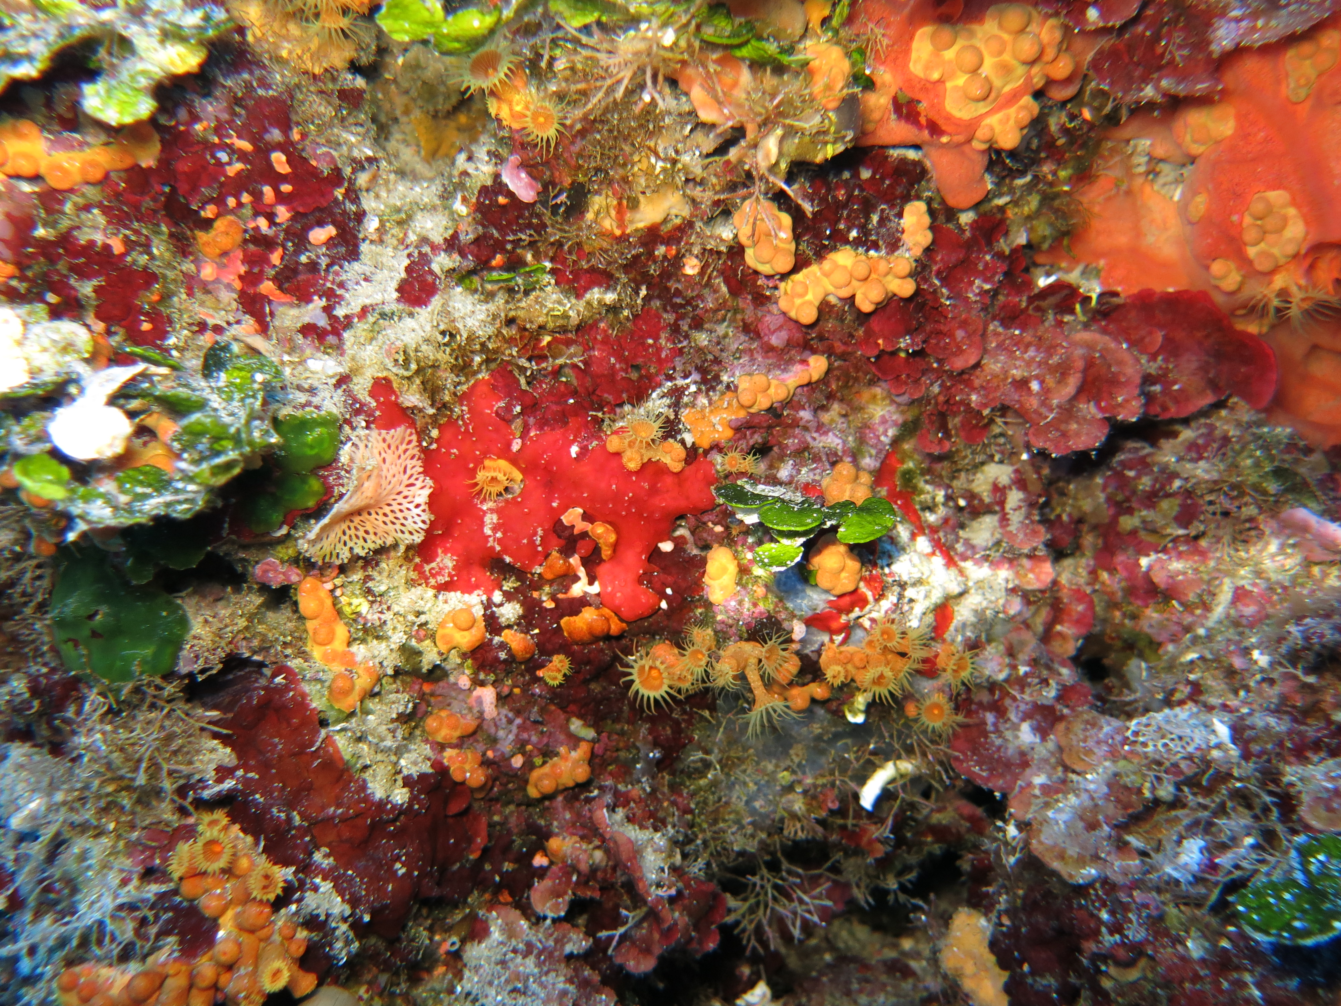
GOOS BioEco Panel and collaborators
http://goosocean.org/
Chairs: Nic Bax and Daniel Dunn
Project Officer: Patricia Miloslavich
Secretariat: Ward Appeltans
Sonia Batten (SAHFOS – Canada), Lisandro Benedetti-Cechi (UP – Italy), Dave Checkley (Scripps – USA), Sanae Chiba (JAMSTEC – Japan), Emmett Duffy (Smithsonian – USA), Albert Fischer (IOC – France), John Gunn (AIMS – Australia), Eduardo Klein (USB – Venezuela), Raphael Kudela (UCSC – USA), Francis Marsac (IRD – France), Frank Muller-Karger (USF – USA), David Obura (CORDIO – Kenya), Yunne Shin (IRD – France), Samantha Simmons (MMC – USA)
Photo credit: Lisandro Benedetti-Cecchi

Slide 21
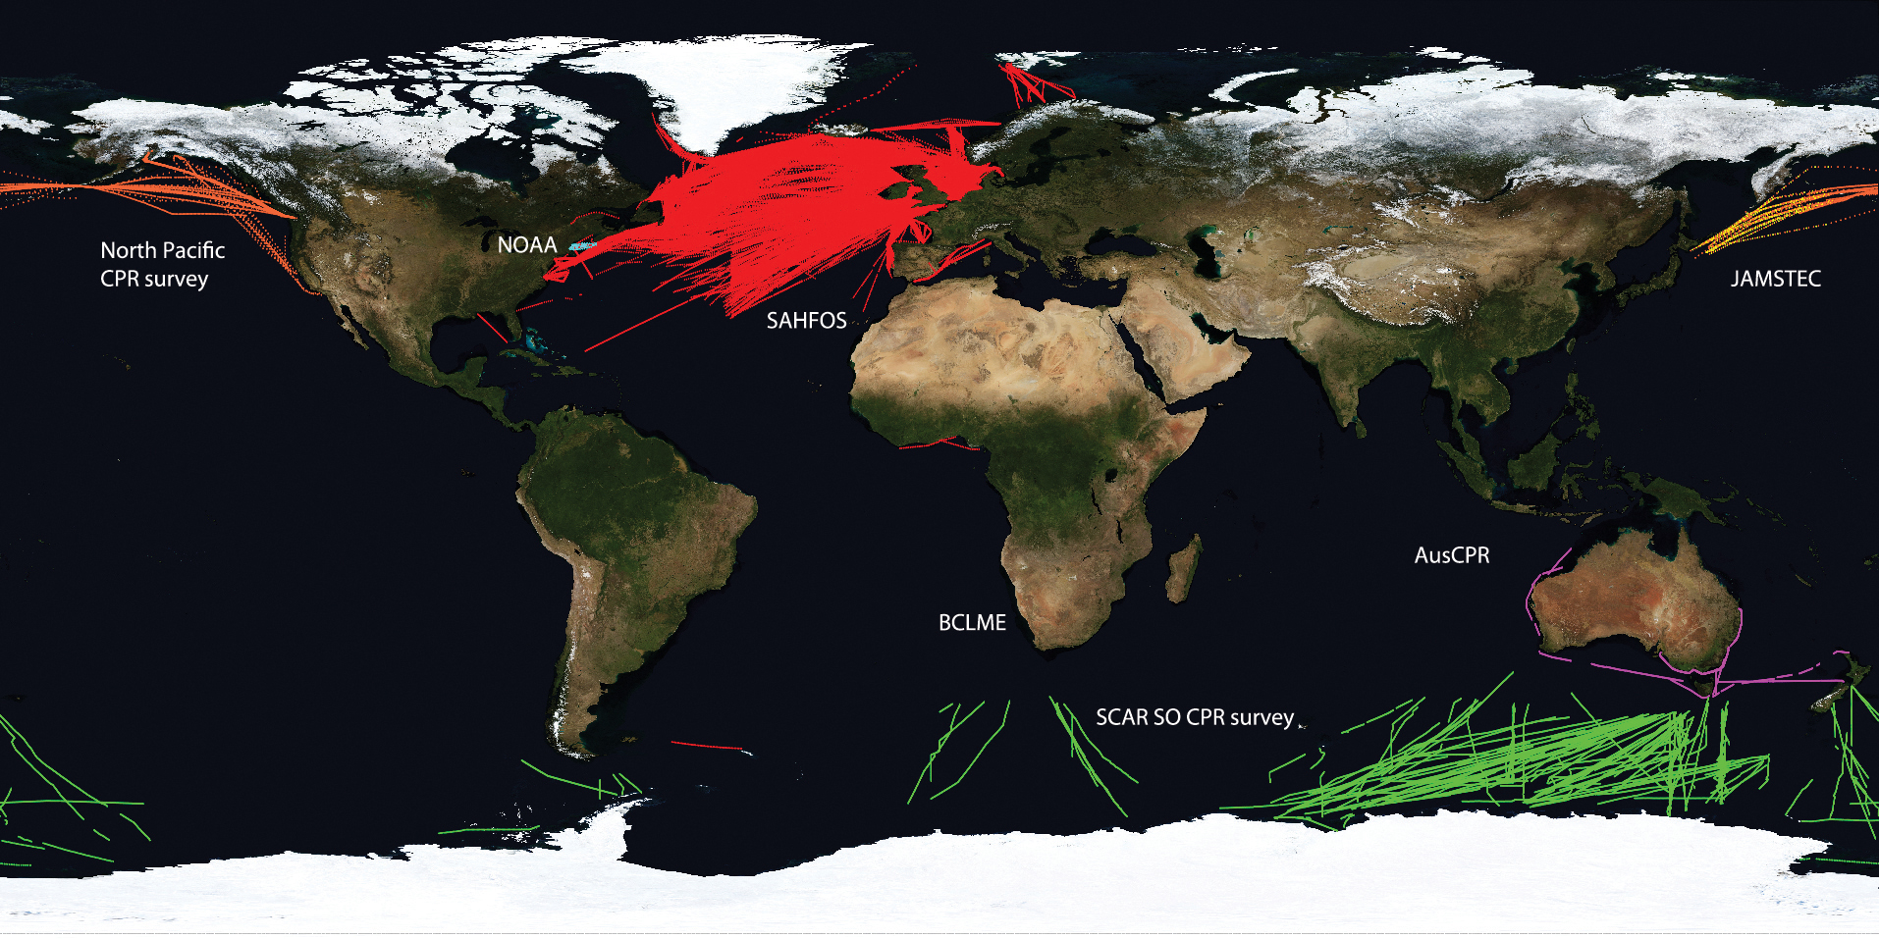
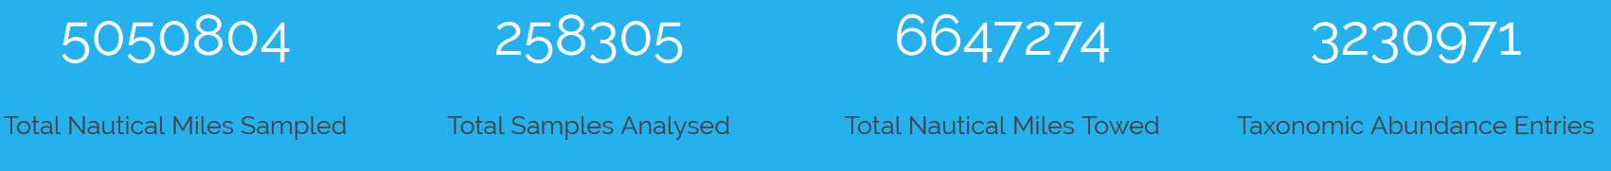
Biological ocean networks:
The Global Alliance of Continuous Plankton Recorders
Variables
Zooplankton diversity, abundance and distribution
Duration
80 years

